Slide 1

STREAMING NETFLIX DATA ON AWS USING APACHE KAFKA, ZOOKEEPER AND FLASK

Slide 2


PROJECT CONTENT
PROJECT SUMMARY
TEAM MEMBERS
SYSTEM ACHITECTURE
DATA ACQUISITION
SET UP AWS ENVIRONMENT
INSTALL KAFKA & ZOOKEEPER
DEVELOP KAFKA PRODUCER
IMPLEMENT KAFKA CONSUMERS
FLASK WEB INTERFACE

Slide 3
PROJECT SUMMARY
Implementing a real-time data streaming solution for Netflix data on Amazon Web Services (AWS) through the utilization of Apache Kafka, Zookeeper and Flask interface presents an exciting and complex endeavor for group diving into the world of big data and cloud computing. Apache Kafka serves as the backbone of this streaming architecture, acting as a distributed streaming platform capable of handling vast amounts of data in real-time.
The project aims to leverage cutting-edge technologies, enhancing both technical proficiency and the ability to address the growing demand for real-time analytics in the streaming industry. By leveraging Flask for the user interface, this project will not only ensure technical proficiency but also market differentiation and strategic growth opportunities.
RETURN

Slide 4
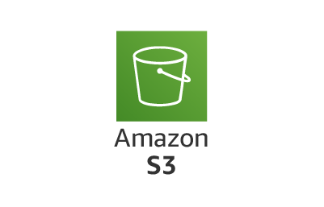





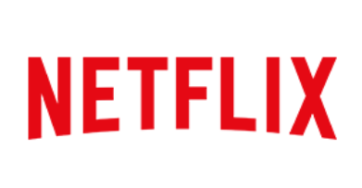
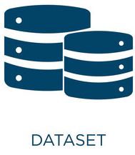
SYSTEM ARCHITECTURE
Consumer
Producer
Consumer
Amazon EC2
RETURN

Slide 5
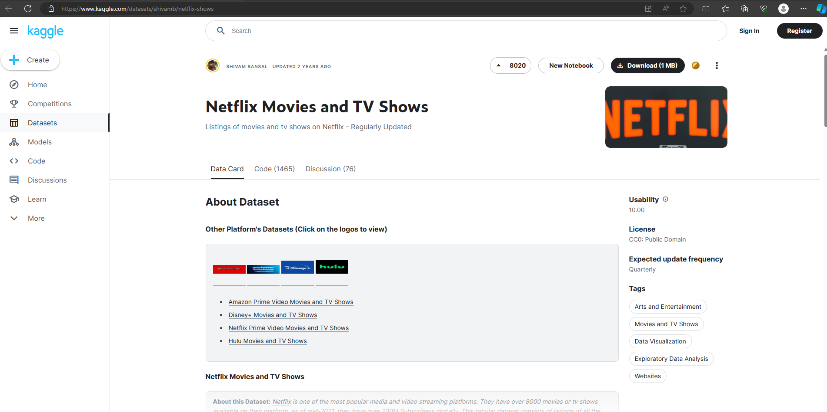
DATA AQUISITION
RETURN

Slide 6
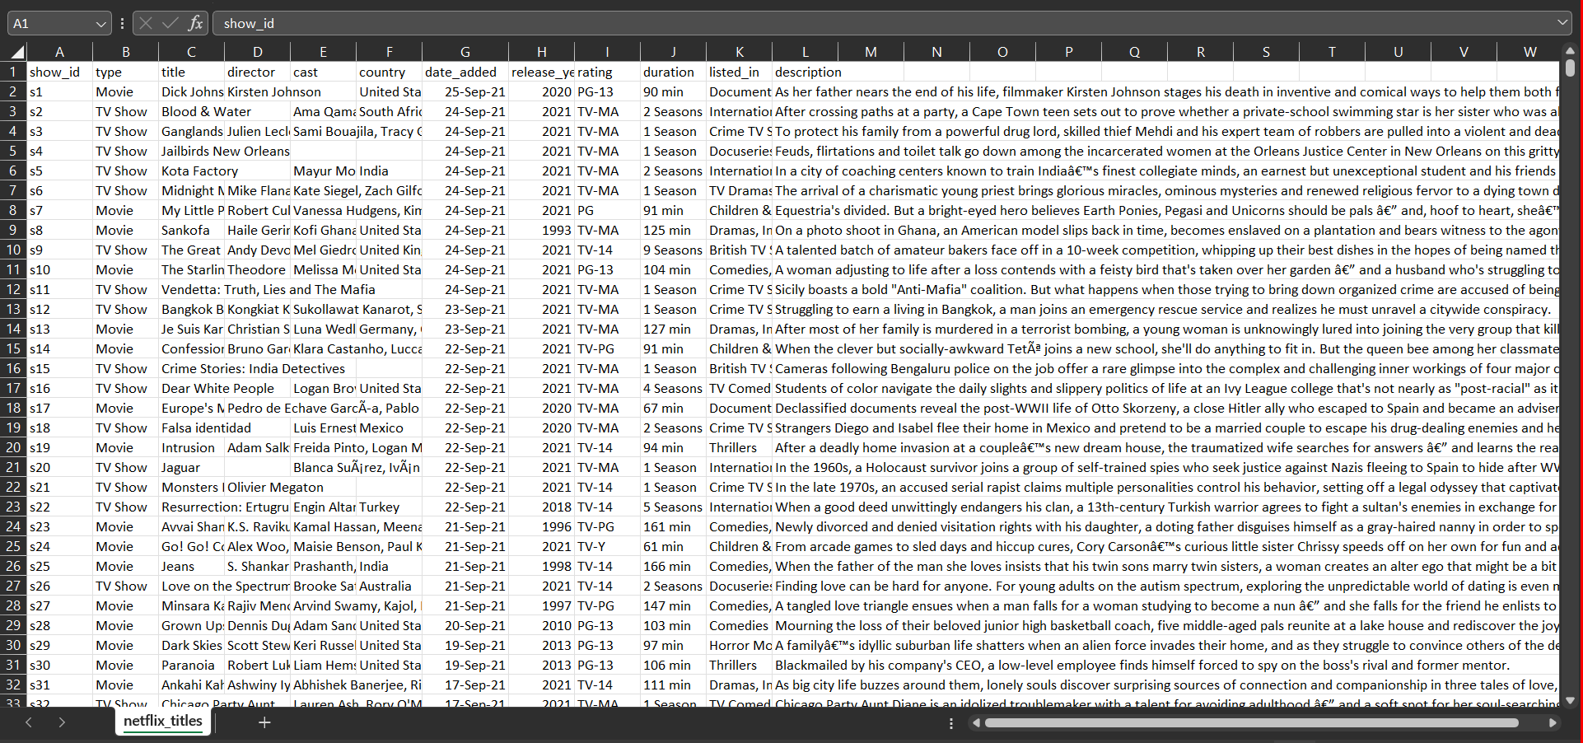
DATA AQUISITION
RETURN

Slide 7
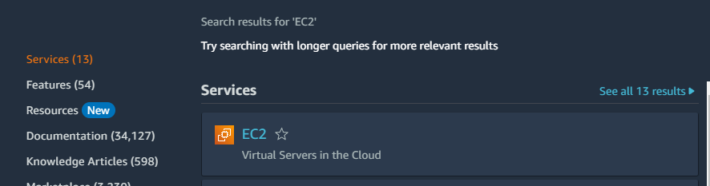
SET UP AWS ENVIRONMENT
RETURN

Slide 8
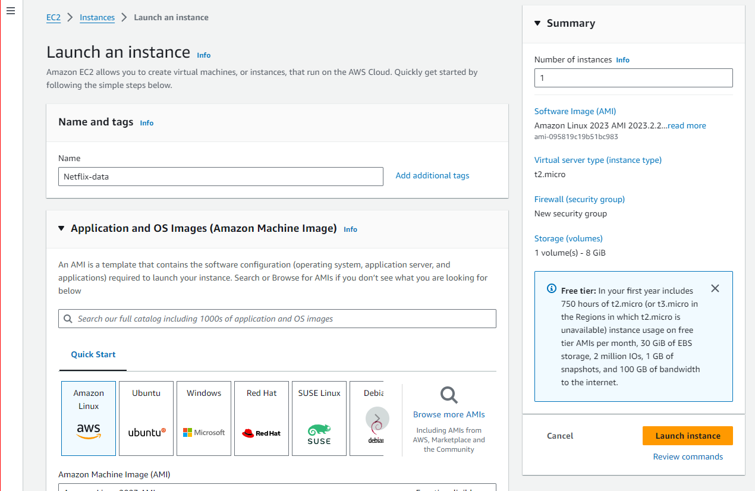
SET UP AWS ENVIRONMENT
RETURN

Slide 9
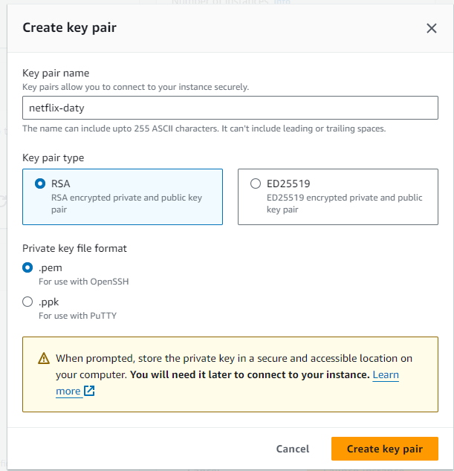
SET UP AWS ENVIRONMENT
RETURN

Slide 10
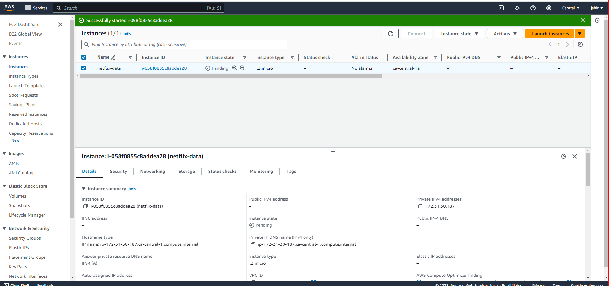
SET UP AWS ENVIRONMENT
RETURN

Slide 11
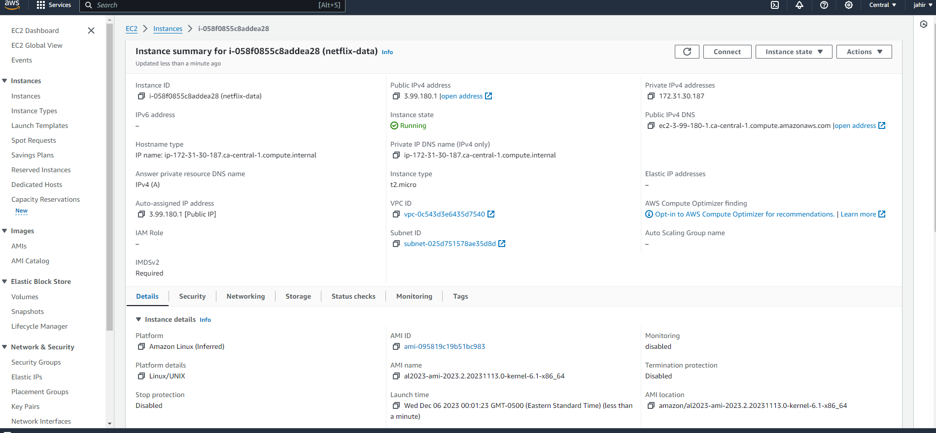
SET UP AWS ENVIRONMENT
RETURN

Slide 12
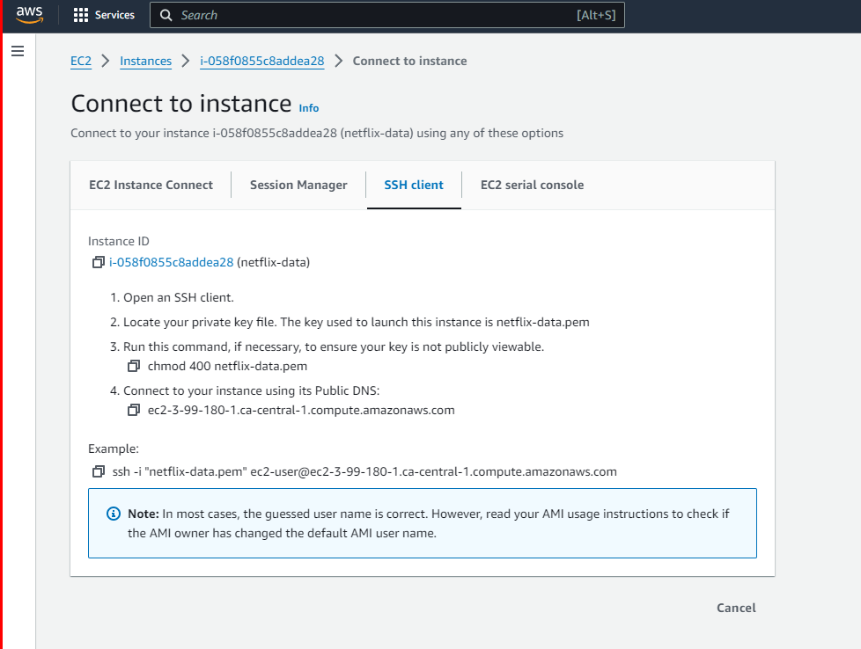
SET UP AWS ENVIRONMENT
RETURN

Slide 13
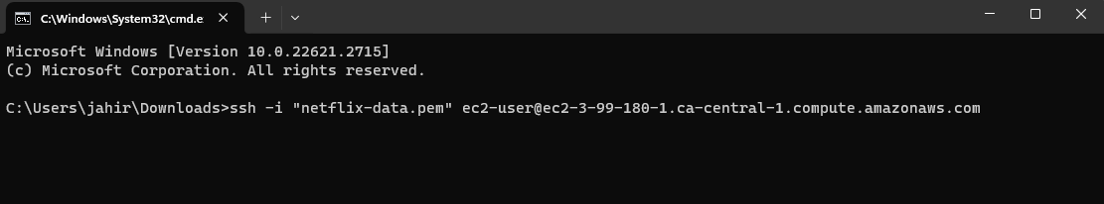
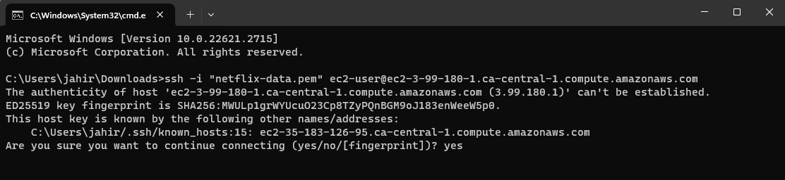
SET UP AWS ENVIRONMENT
RETURN

Slide 14
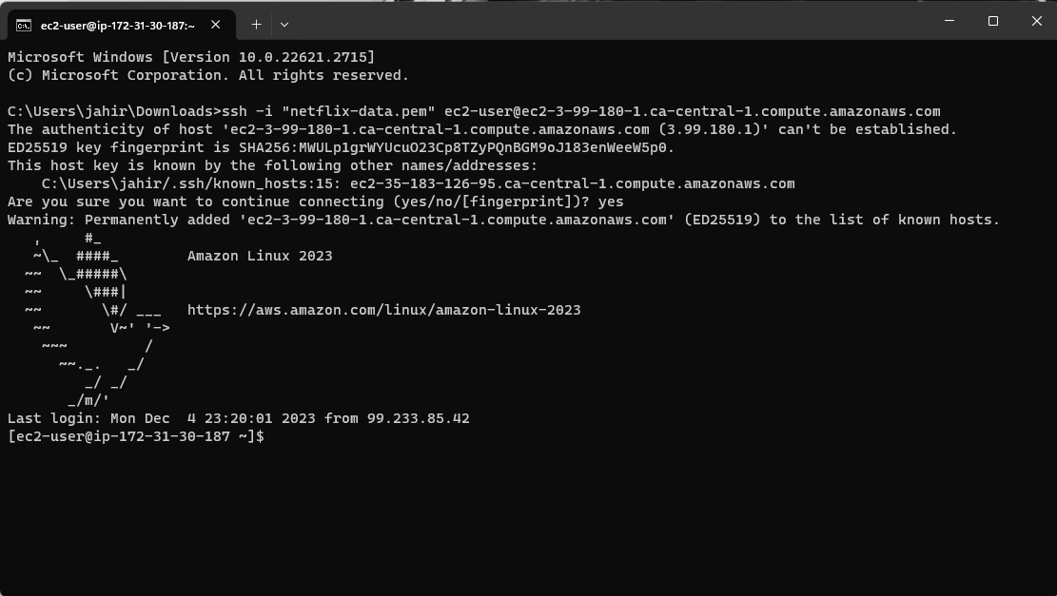
SET UP AWS ENVIRONMENT
RETURN

Slide 15
INSTALL KAFKA & ZOOKEEPER
https://georgiancollege-my.sharepoint.com/:t:/g/personal/200546259_student_georgianc_on_ca/Ed8Hr_9KxBxGtJRBilkey_sB-ZQBPX405EyxWRX3v4KbPA?e=yqRhbV
https://georgiancollege-my.sharepoint.com/:t:/g/personal/200546259_student_georgianc_on_ca/EXbCDWaVpaZHn6xPy7RwKEABo9FTusWHKuMAgLyfezSC8g?e=kAueFq
RETURN

Slide 16
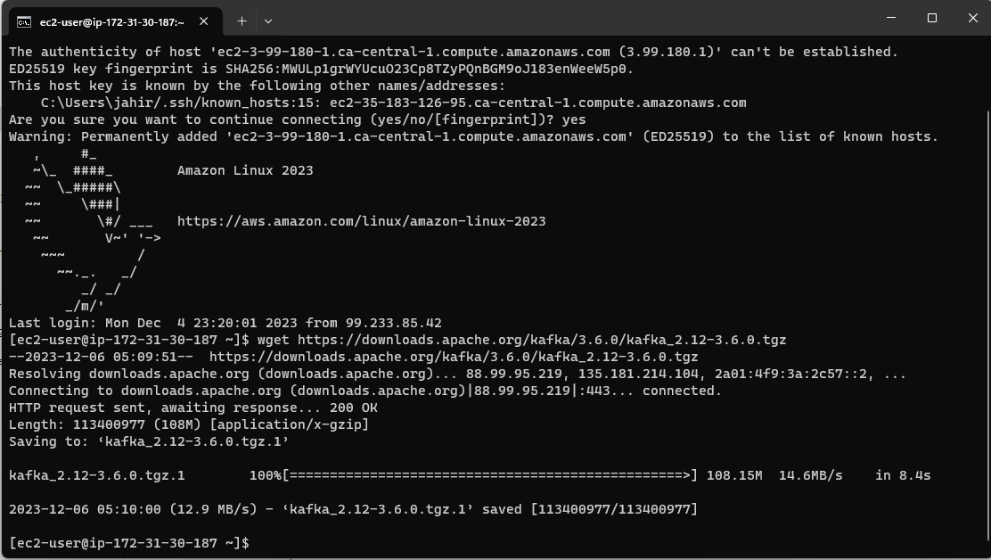
INSTALL KAFKA & ZOOKEEPER
RETURN

Slide 17
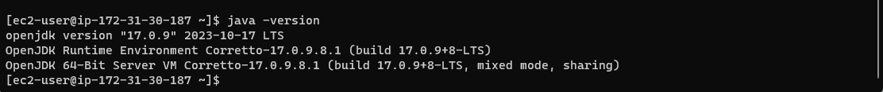
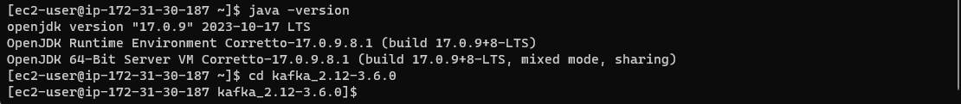
INSTALL KAFKA & ZOOKEEPER
RETURN

Slide 18
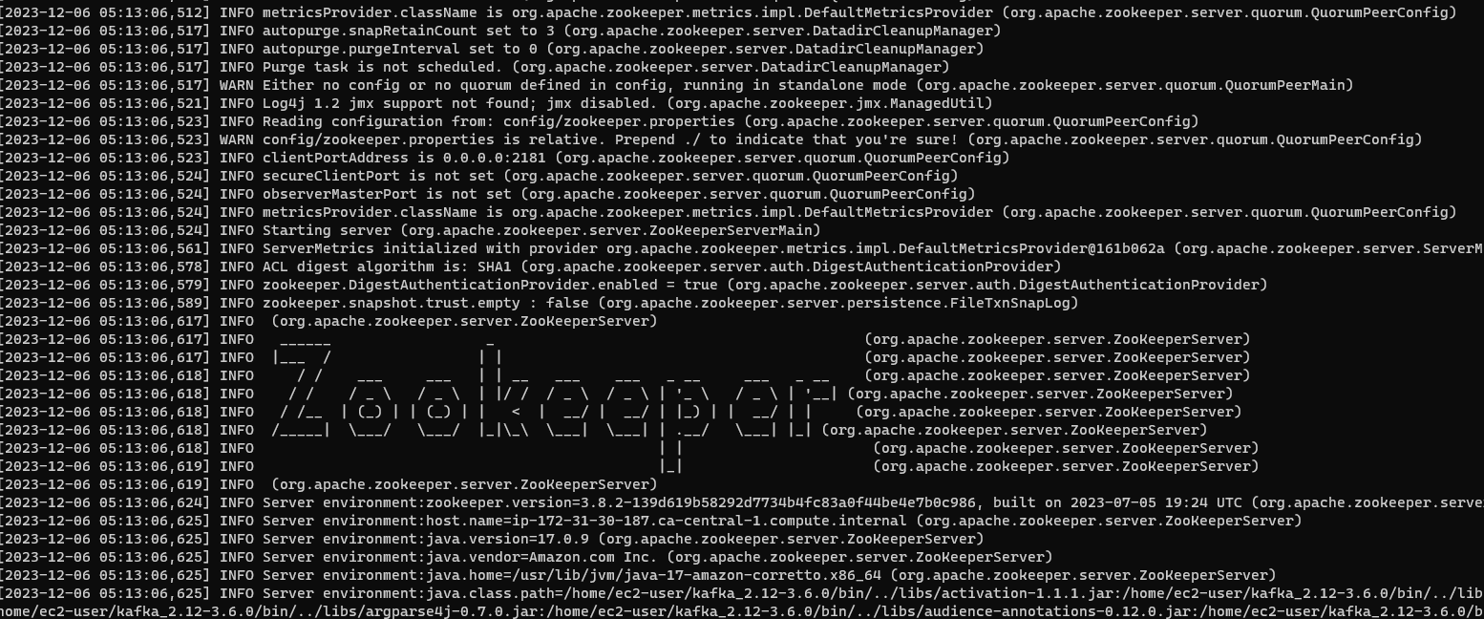
INSTALL KAFKA & ZOOKEEPER
RETURN

Slide 19
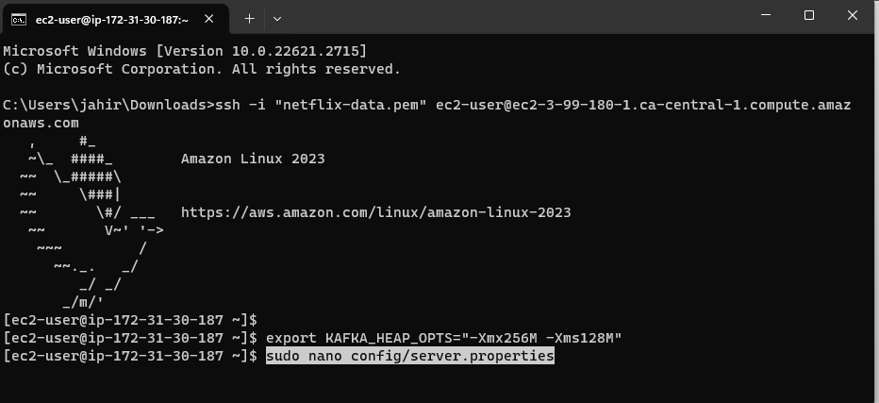
INSTALL KAFKA & ZOOKEEPER
RETURN

Slide 20
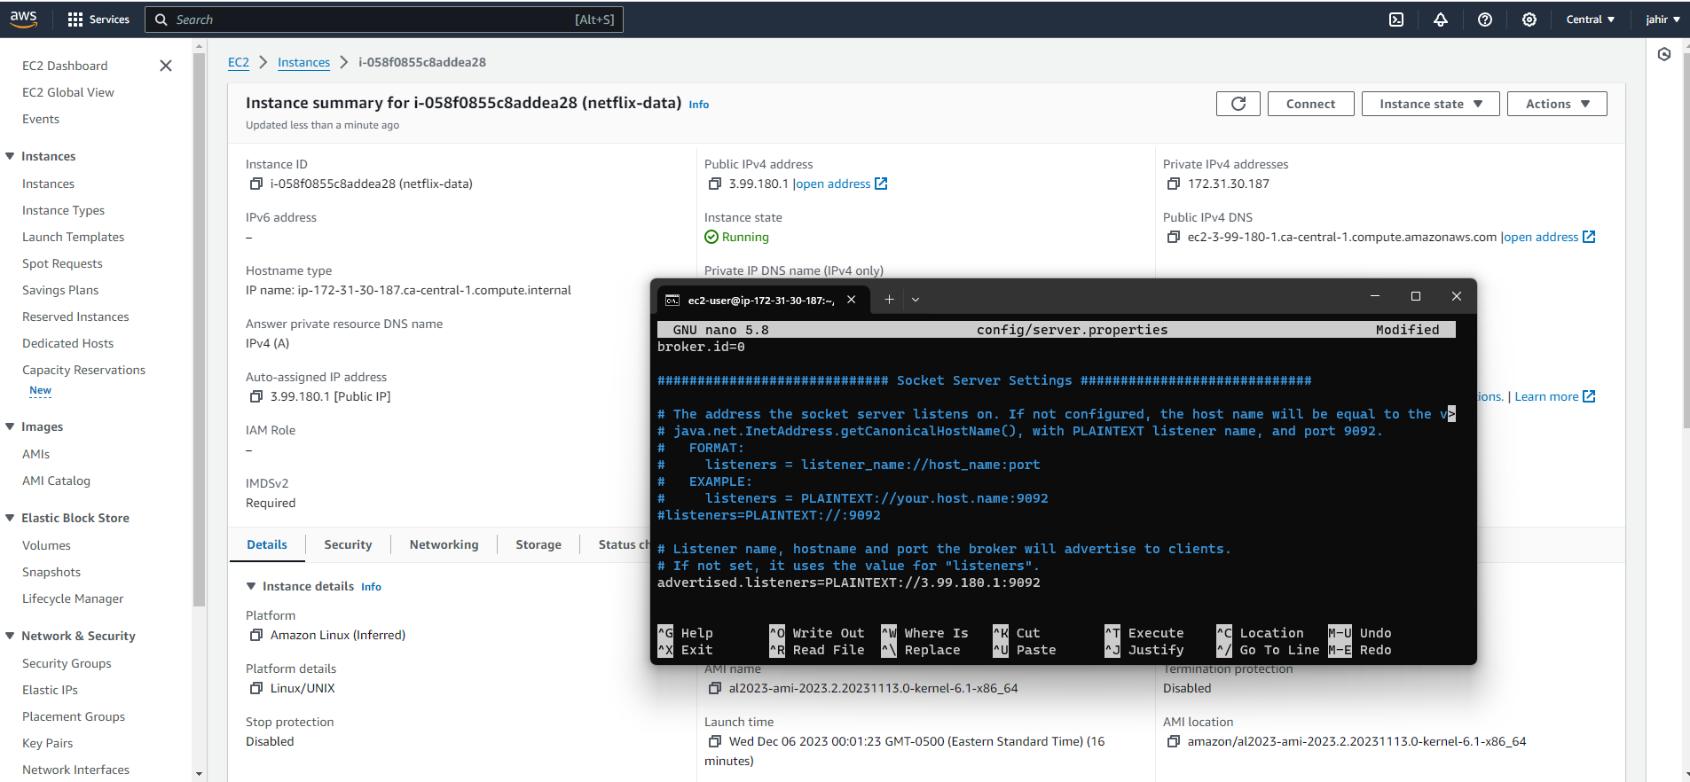
INSTALL KAFKA & ZOOKEEPER
RETURN

Slide 21
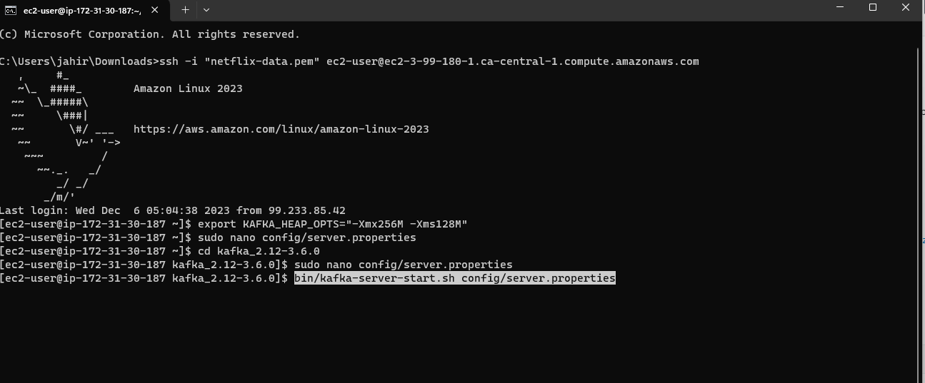
INSTALL KAFKA & ZOOKEEPER
RETURN

Slide 22
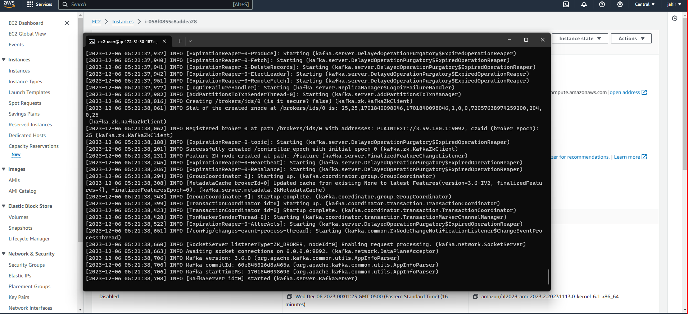
INSTALL KAFKA & ZOOKEEPER
RETURN

Slide 23
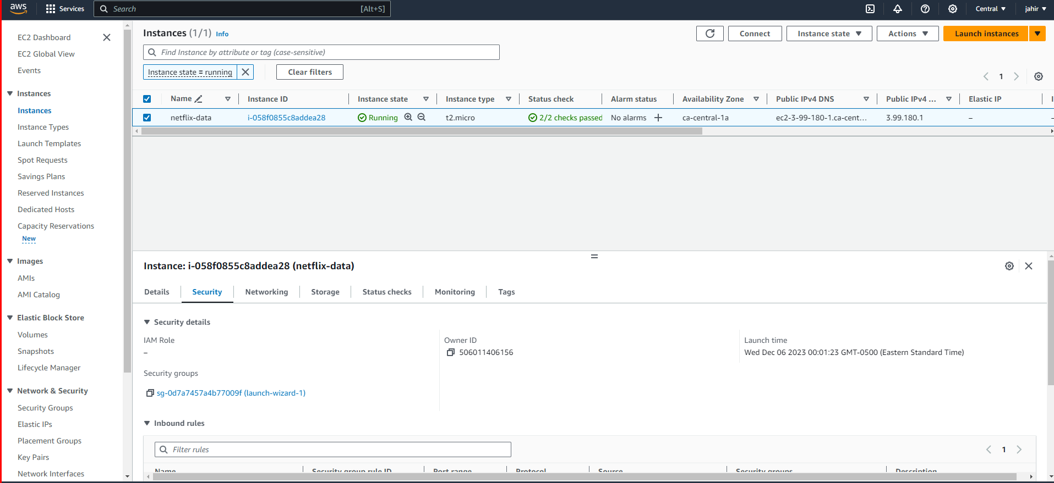
INSTALL KAFKA & ZOOKEEPER
RETURN

Slide 24
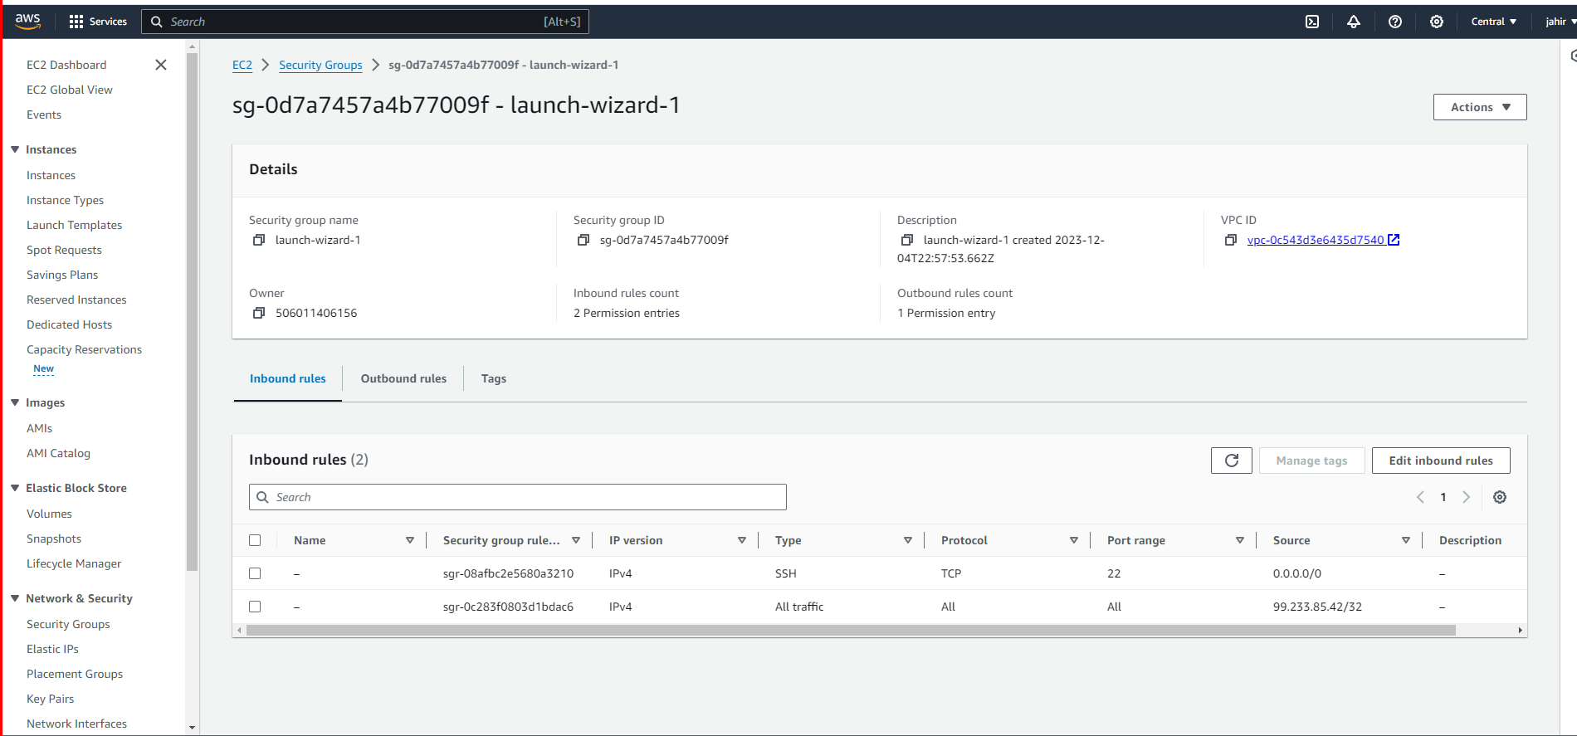
INSTALL KAFKA & ZOOKEEPER
RETURN

Slide 25
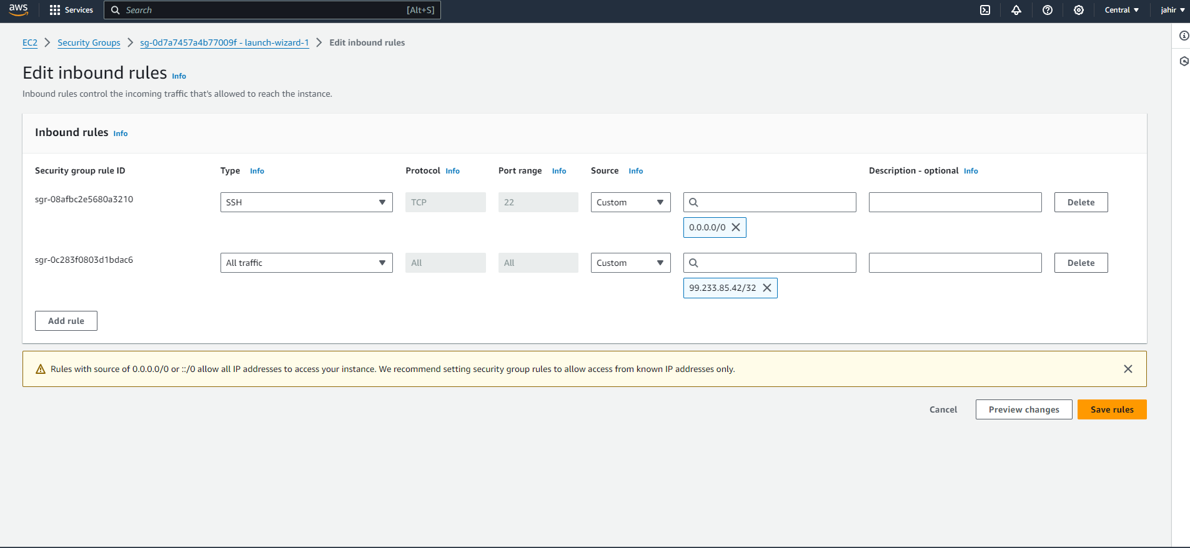
INSTALL KAFKA & ZOOKEEPER
RETURN

Slide 26
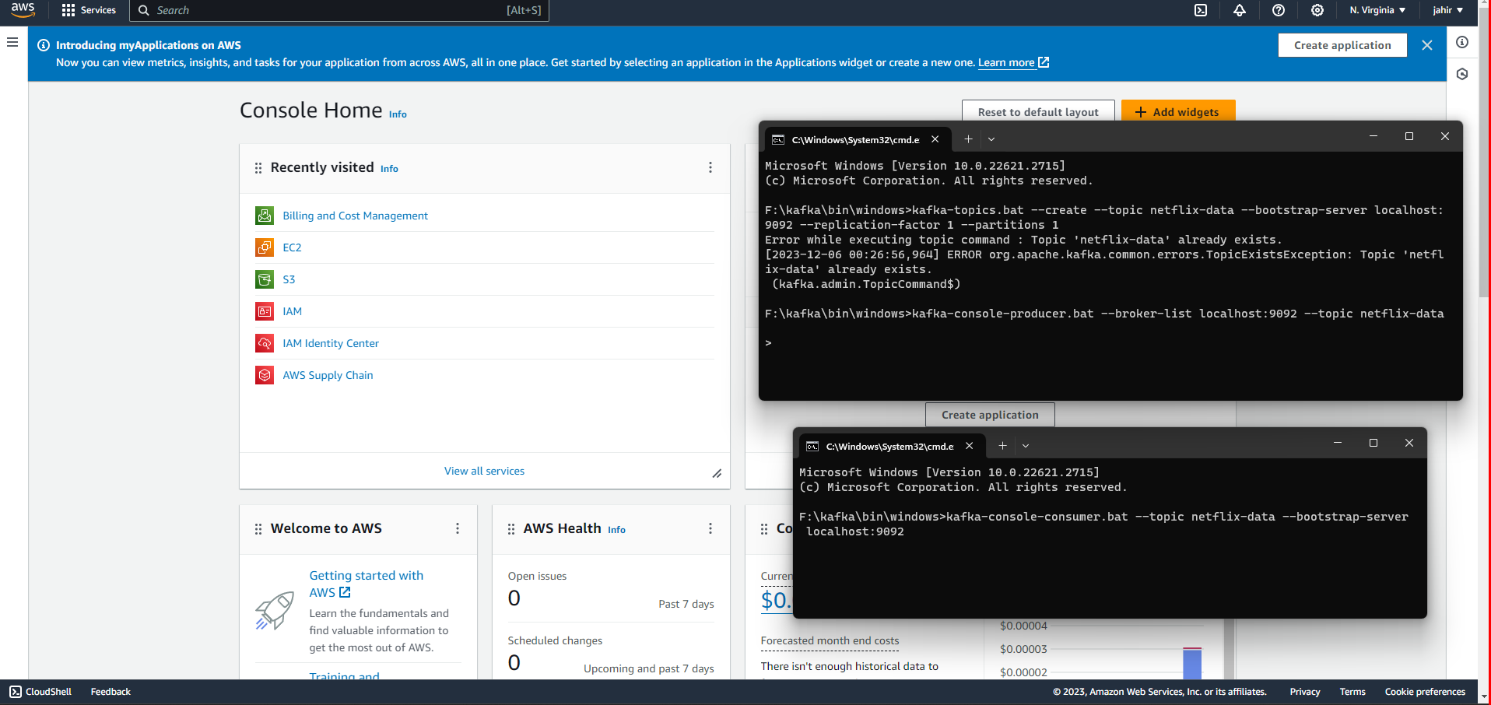
DEVELOP KAFKA PRODUCER
RETURN

Slide 27
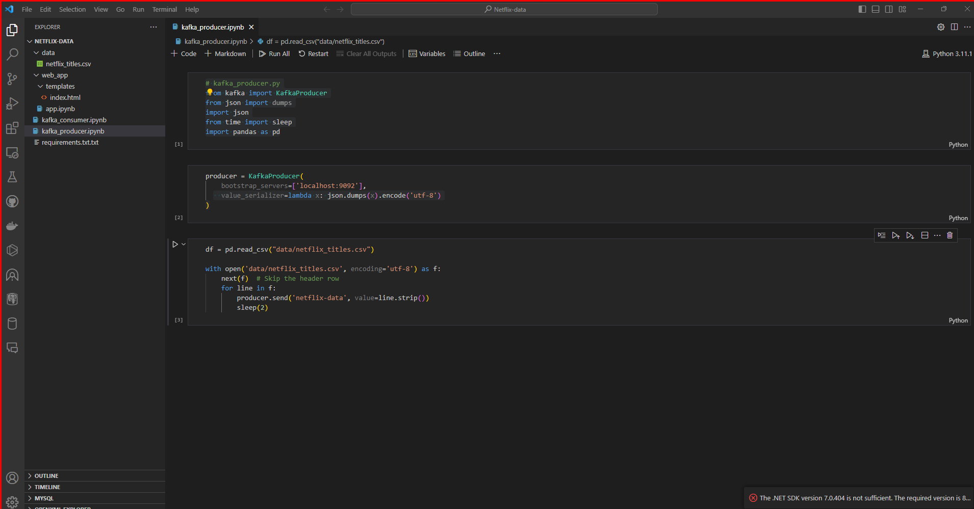
DEVELOP KAFKA PRODUCER
RETURN

Slide 28
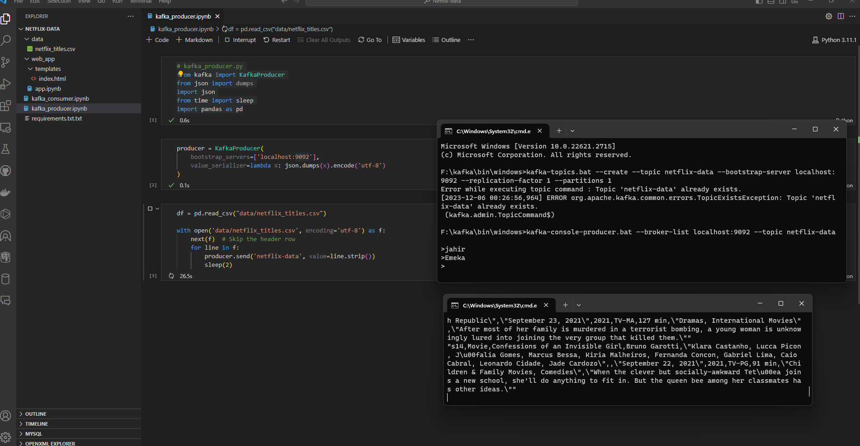
DEVELOP KAFKA PRODUCER
RETURN

Slide 29
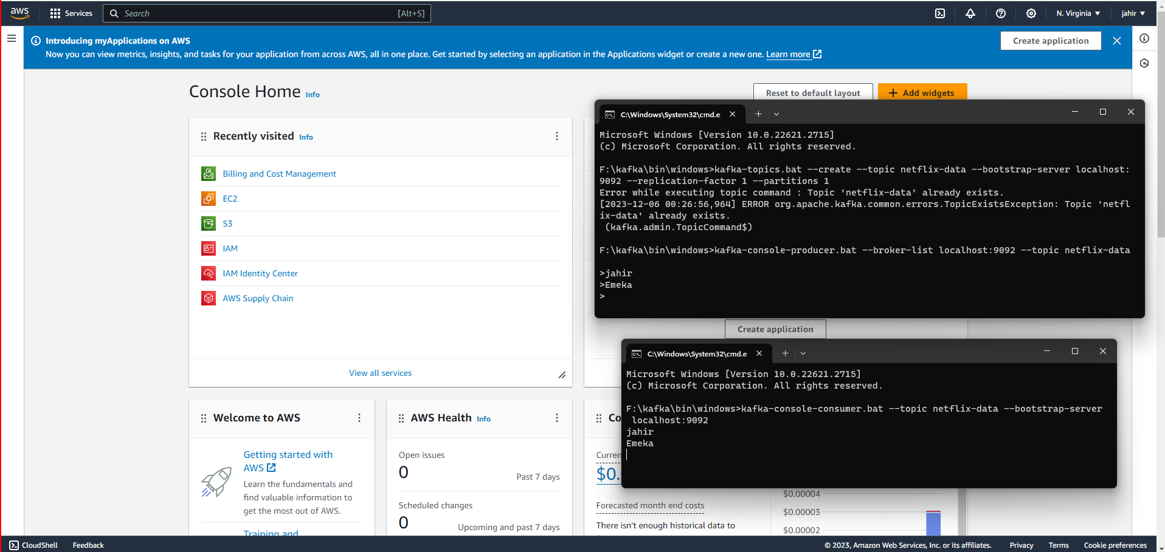
IMPLEMENT KAFKA CONSUMER
RETURN

Slide 30
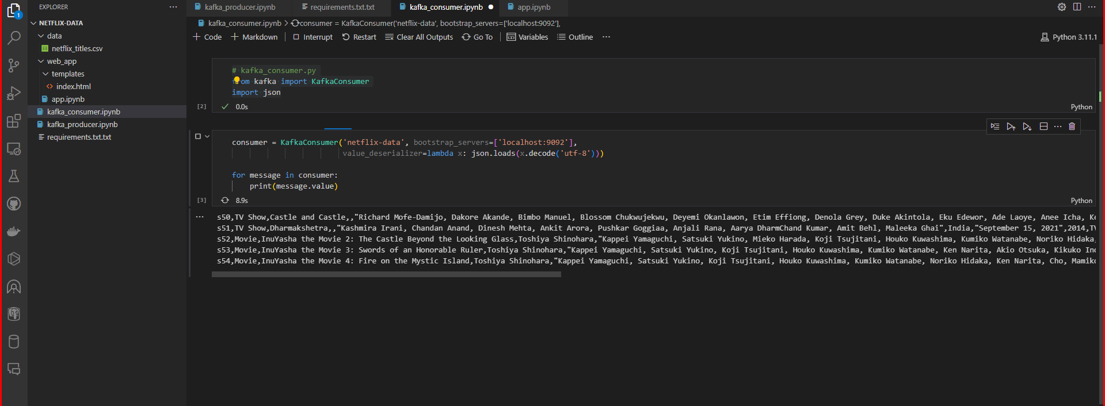
IMPLEMENT KAFKA CONSUMER
RETURN

Slide 31
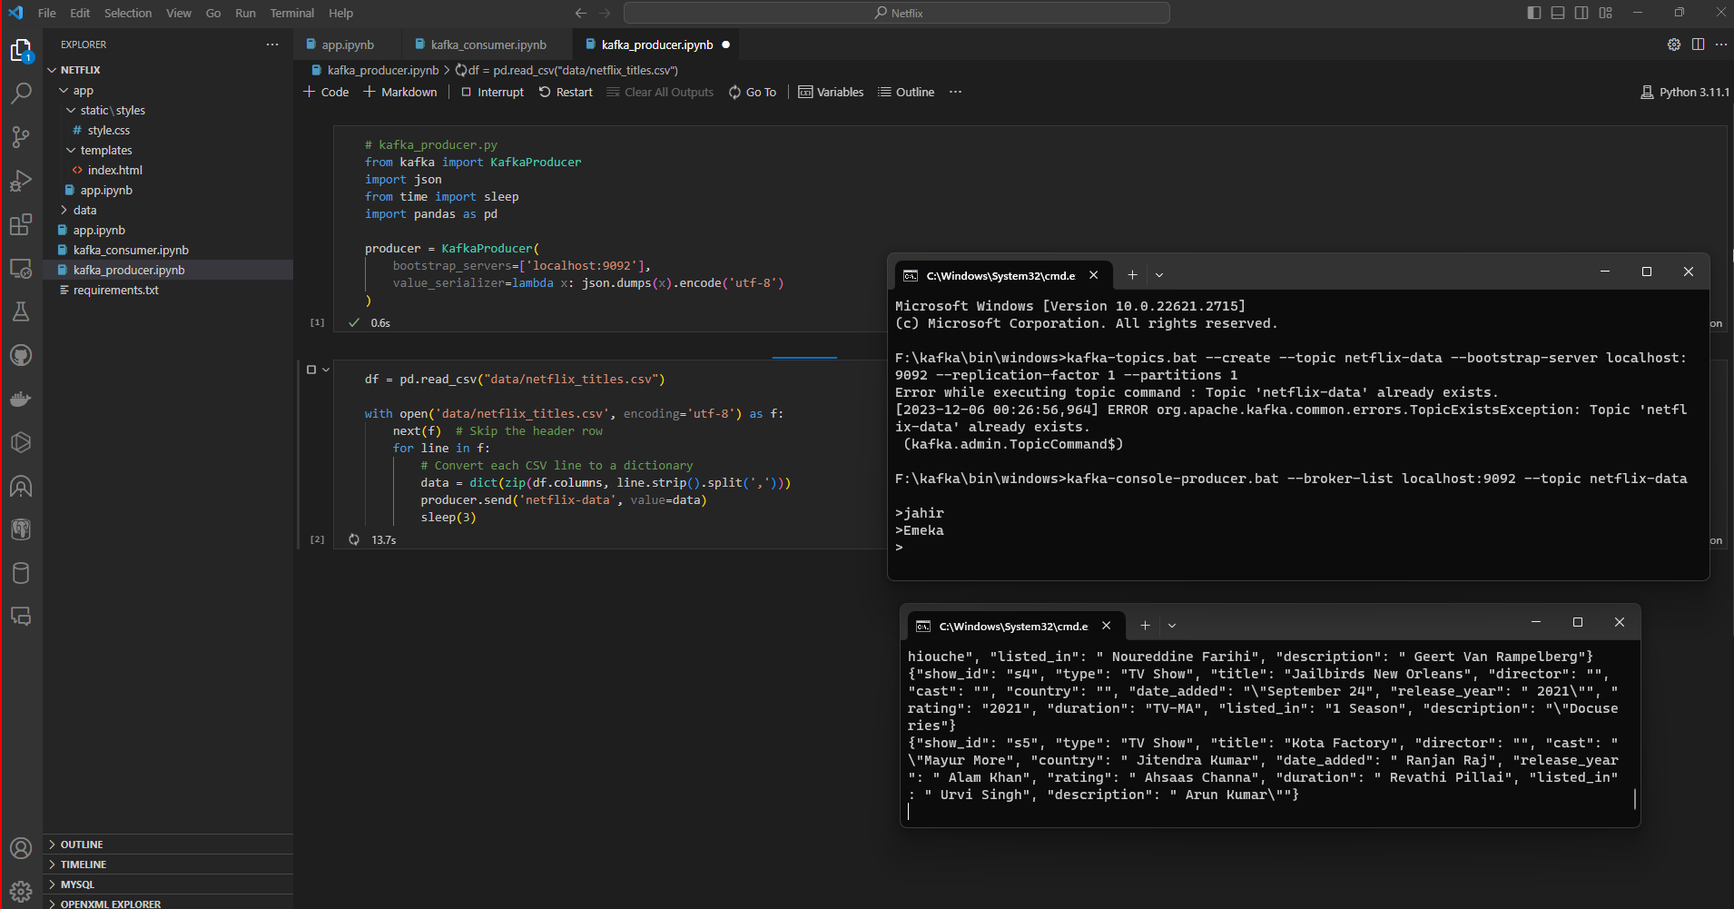
IMPLEMENT KAFKA CONSUMER
Consumer receiving data every 3 seconds from the producer
RETURN

Slide 32
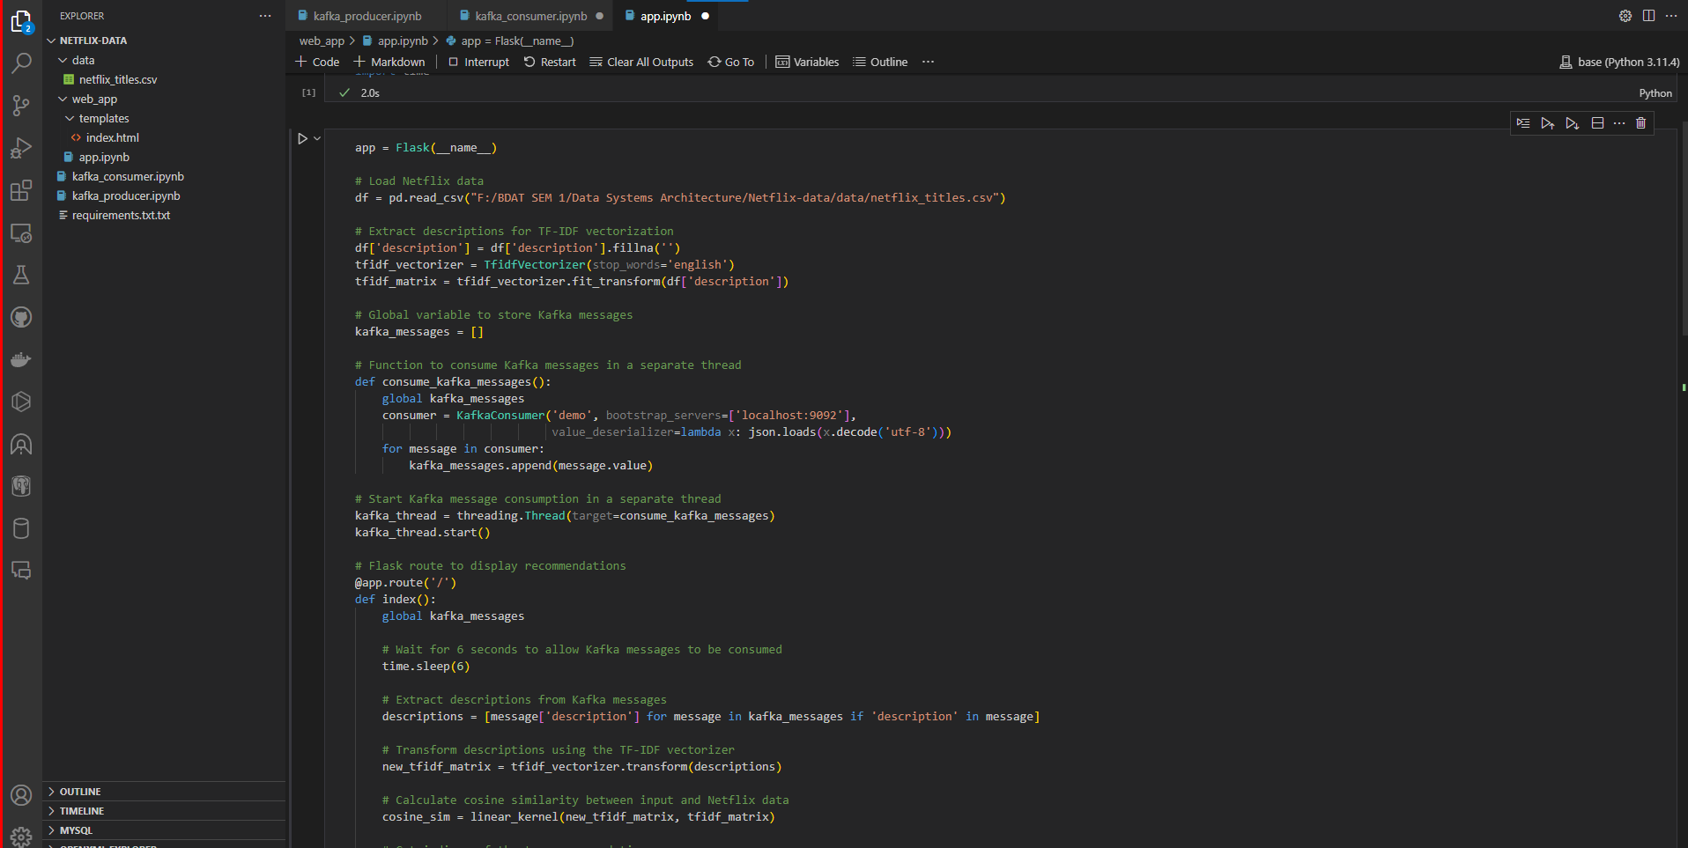
FLASK WEB INTERFACE
RETURN

Slide 33
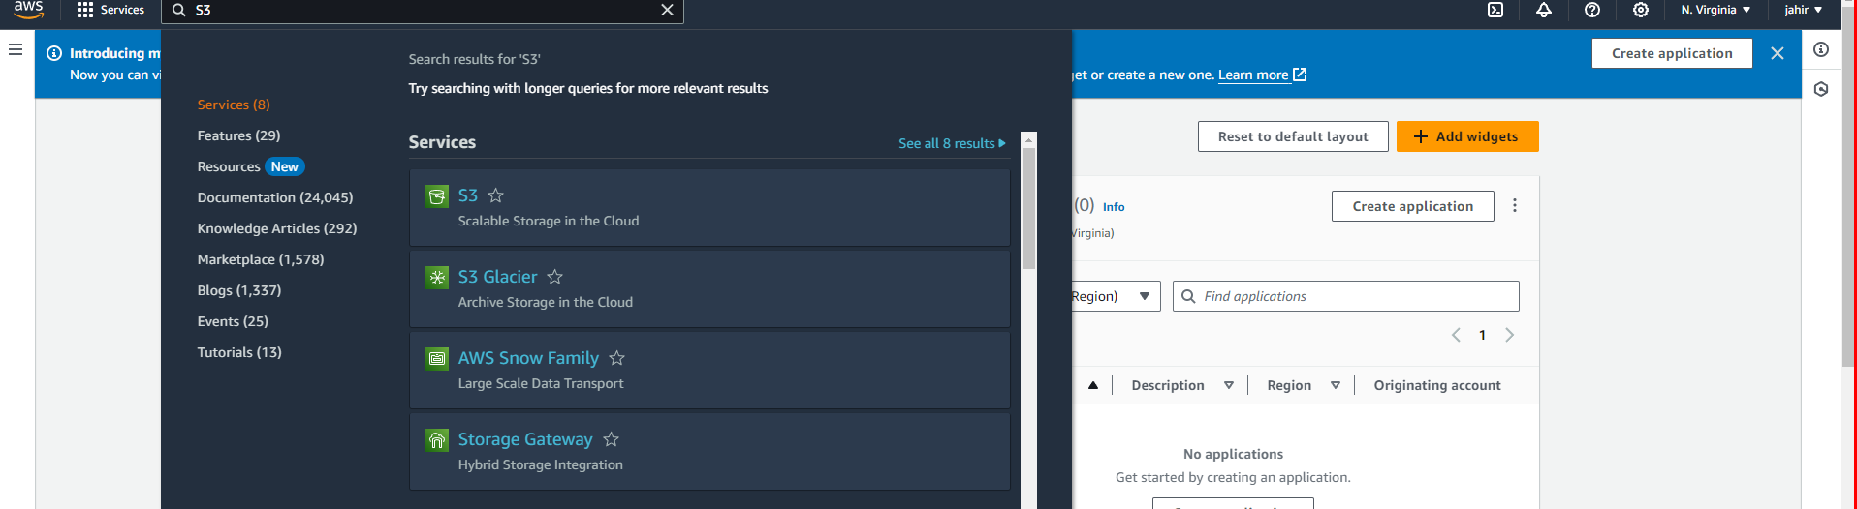
FLASK WEB INTERFACE
S3 Bucket used to store Json data from Netflix
RETURN

Slide 34
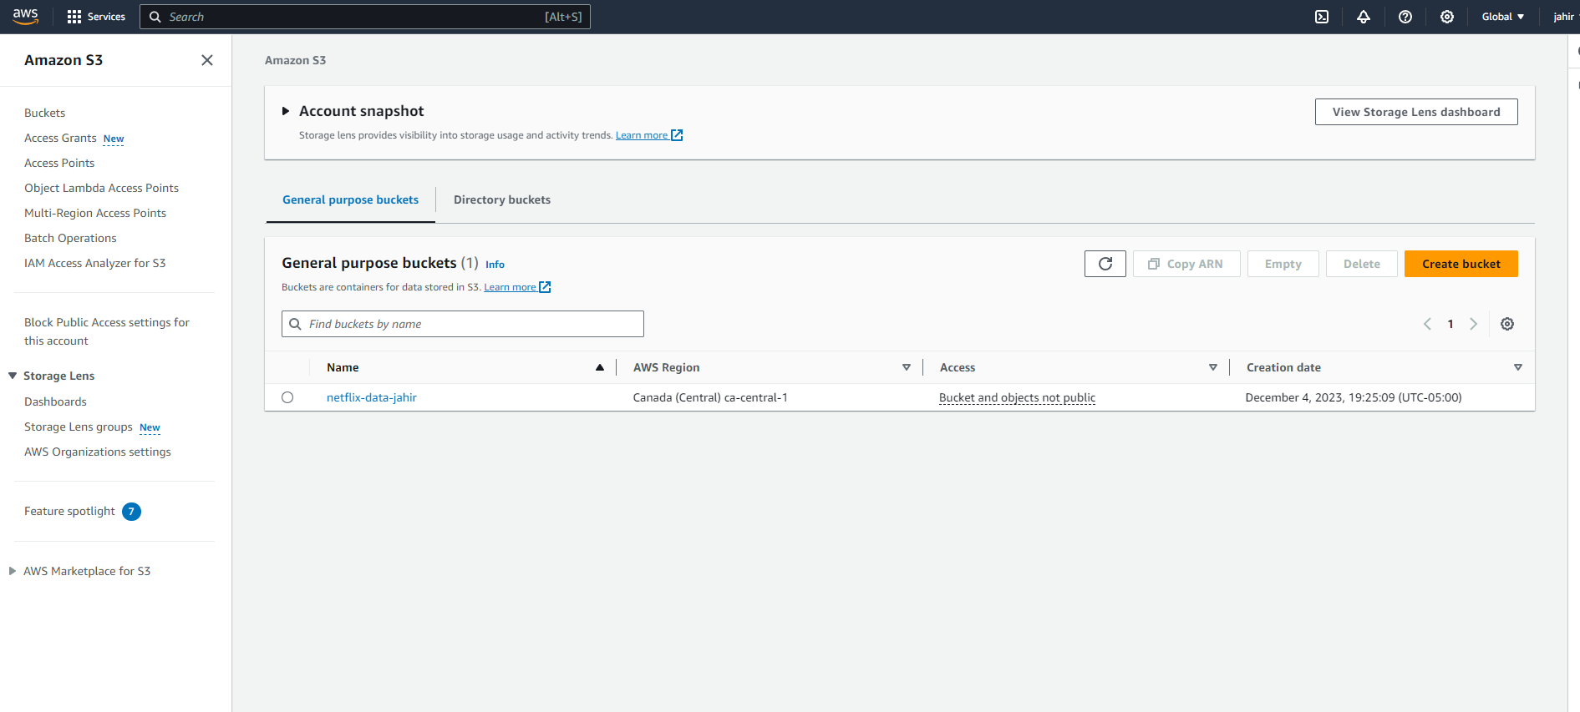
FLASK WEB INTERFACE
S3 Bucket Interface
RETURN

Slide 35
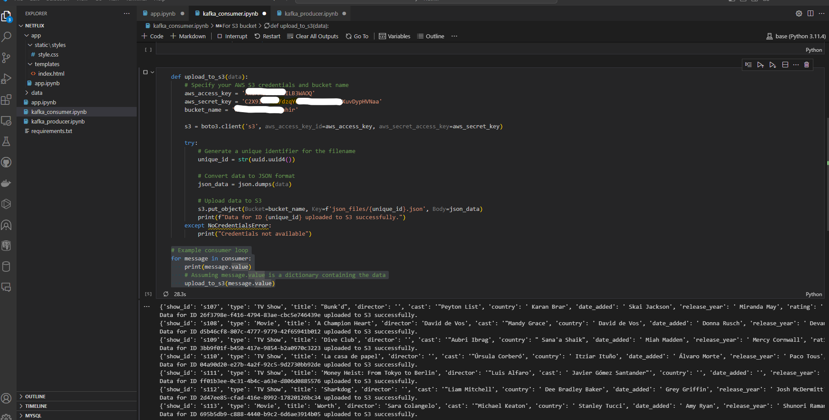
FLASK WEB INTERFACE
Sending data to S3 Bucket in Json format
RETURN

Slide 36
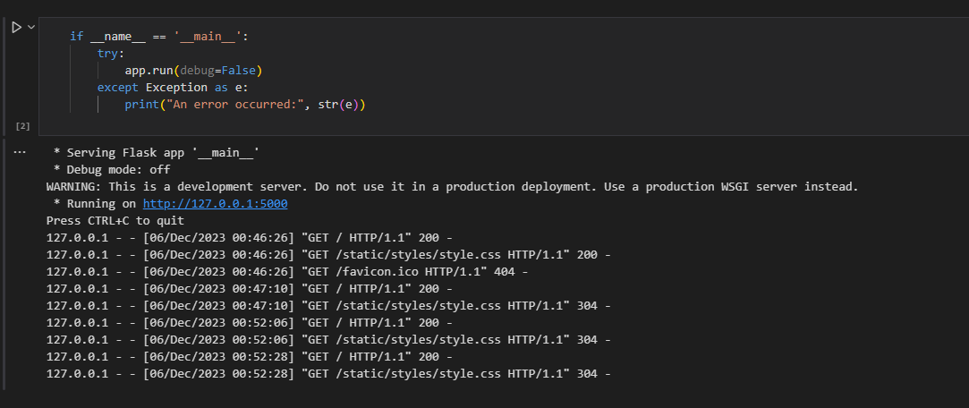
FLASK WEB INTERFACE
RETURN

Slide 37
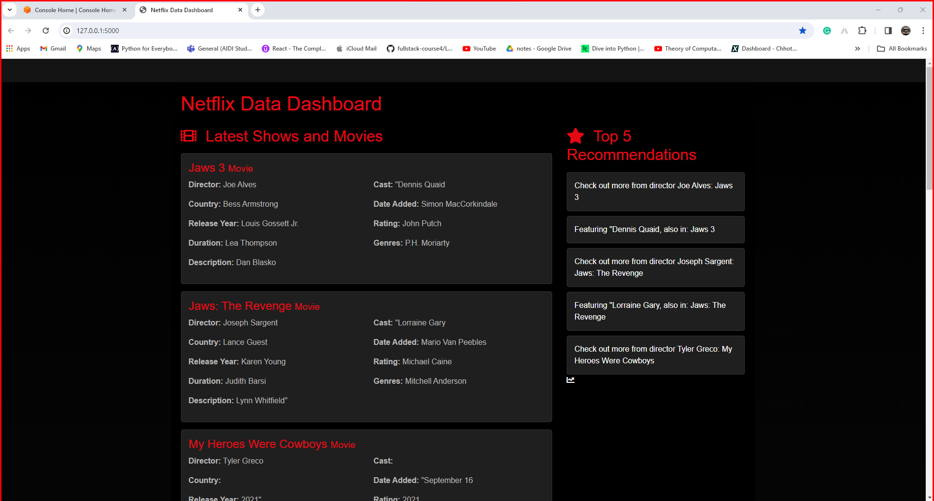
FLASK WEB INTERFACE
RETURN

